Slide 1
Simulation of subjects in solo fitting with Q learning model
Aim of the simulation: Getting the range of fitted parameters (learning rate and behavioral temperature)
For fast and slow learners

Slide 2

Method: How I defined learning speed for each simulated subject?
There is a parameter in the code named:
It governs the time is needed that a subject goes from random choice from (1,2) toward more selecting the option that leads to value 2.

Slide 3
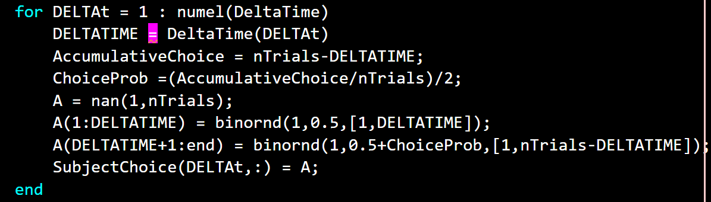
How I generate the choices for each subject?
Each choice is generated by random binary generator with specific probability favoring more choices toward reward value 2

Slide 4
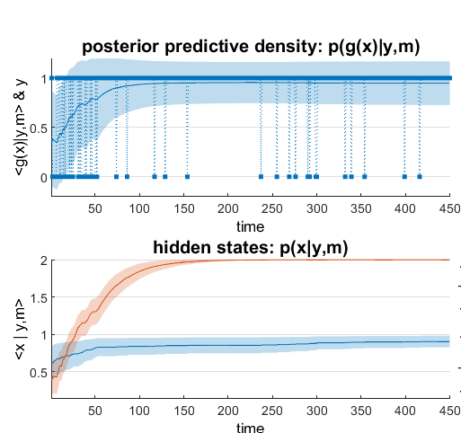
Sanity check: choice profile of different learners

Slide 5
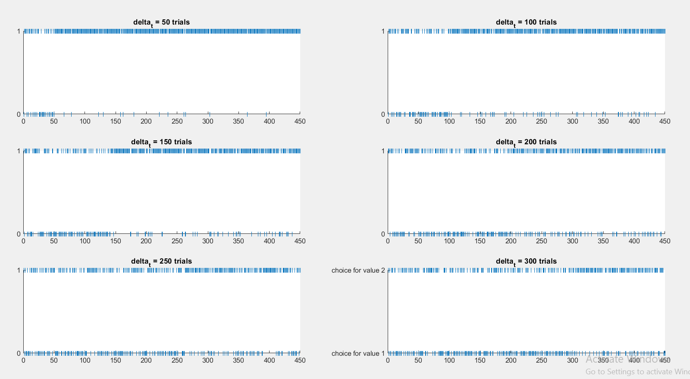

Slide 6
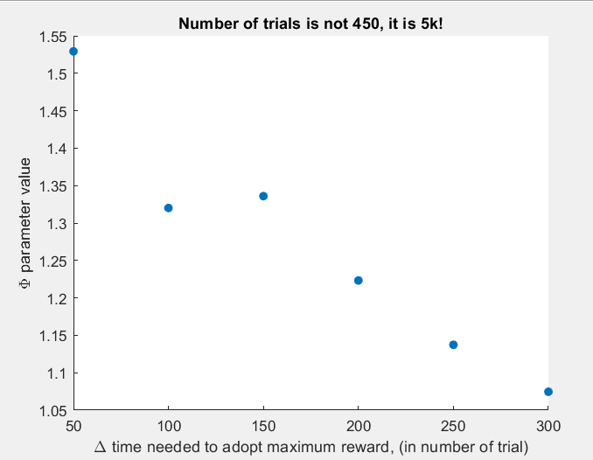
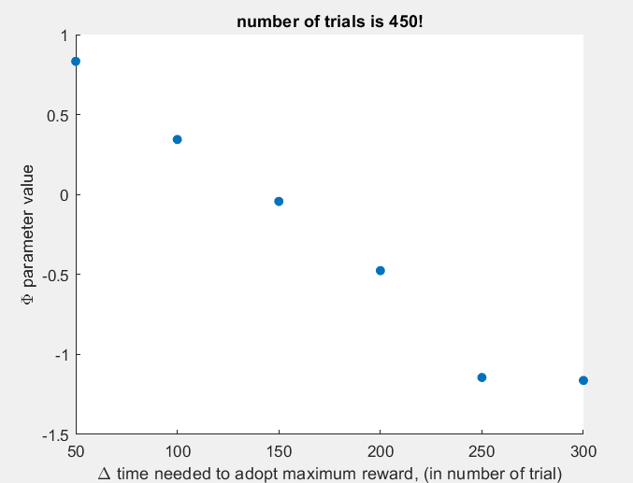
Results: Behavioral temperature parameter

Slide 7
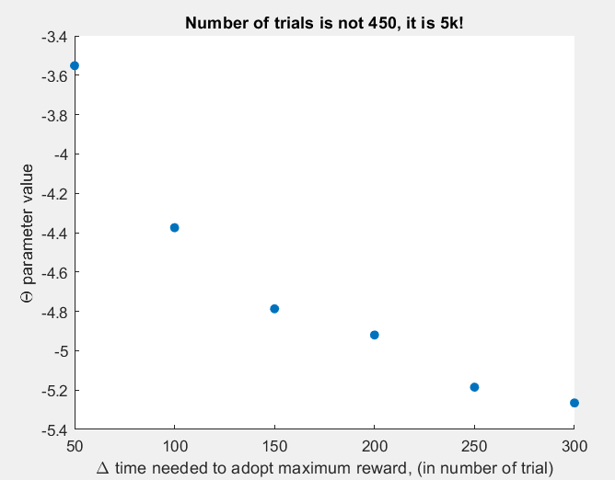
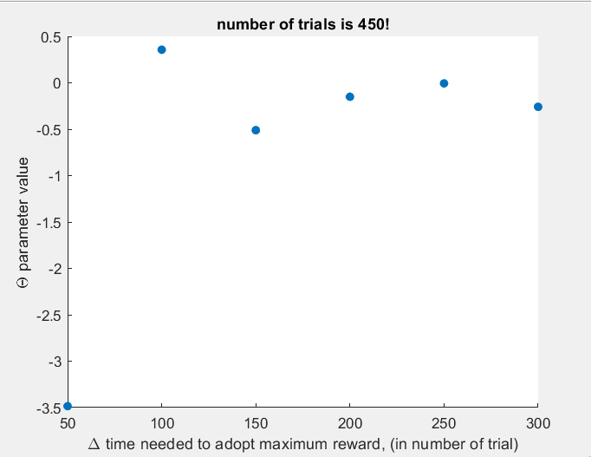
Results: Learning rate parameter
Question: What does it mean to have a NEGATIVE evolution parameter in Q learning?

Slide 8
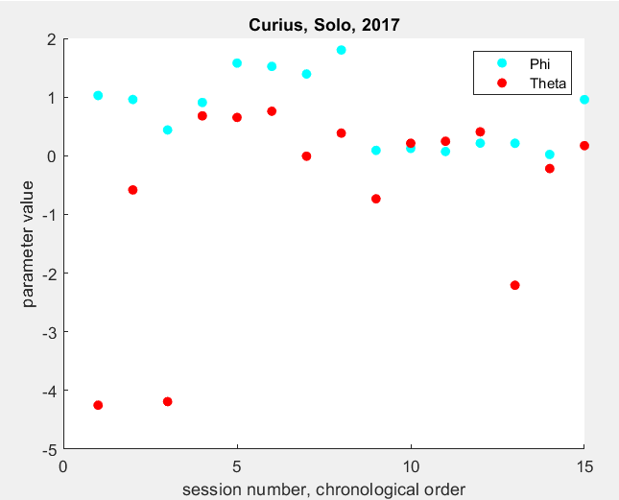
Real data is inside the range?

